Slide 1
Image based breed recognition for cattle and buffaloes of India
CSE7302- University Project
Review-1
Batch Number: ISE_02
Under the Supervision of,
Mr. John Bennet J
Assistant Professor
School of Computer Science and Engineering
Presidency University
Roll Number 20221ISE0032 20221ISE0062 | Student Name Aditya V S Chiranthan T C Nadig
Name of the Program: Information Science and Engineering
Name of the HOD: Dr. Gopal K Shyam
Name of the Program Project Coordinator: Ms. Sumita Guddin

Slide 2
Content
Problem Statement
Analysis of Problem Statement
Introduction
Background and Related Work
Proposed Approach and Objectives
Software and Hardware Requirements
Flow Diagram
Timeline of the Project
GitHub Link
References

Slide 3
Problem Statement: SIH25004
Organization: Ministry of Fisheries, Animal Husbandry & Dairying
Problem Title: Image based breed recognition for cattle and buffaloes of India
Category: Software
Problem ID: SIH25004
Domain: Agriculture, FoodTech & Rural Development
SDG Alignment: SDG 2 – Zero Hunger

Slide 4
Problem Statement: SIH25004
Problem Description: India possesses a rich diversity of indigenous cattle and buffalo breeds that are vital for milk production, agriculture, and rural livelihoods. However, accurate identification of these breeds is still largely dependent on manual observation by experts, which is time-consuming, subjective, and often unavailable to farmers and field officials. Many Indian breeds share similar physical characteristics, making breed differentiation difficult without specialized knowledge. The absence of an automated and reliable digital system for breed recognition leads to misclassification, affects breeding programs, and limits effective conservation of native genetic resources. Therefore, there is a strong need for an image-based breed recognition system that uses computer vision and deep learning techniques to accurately identify Indian cattle and buffalo breeds, enabling faster, consistent, and accessible breed identification.

Slide 5
Analysis of Problem Statement
ANALYSIS
Manual breed identification requires expert knowledge.
High similarity between many Indian breeds.
Lack of easily accessible digital tools for farmers and officials.
Existing datasets are limited or scattered
Visual features such as coat color, horn shape, face structure, and body pattern are important for breed identification
Traditional methods are inconsistent and subjective
Deep learning can automatically extract features from images
PROBLEM
Develop an image-based breed recognition system using deep learning
Train models on Indian cattle and buffalo breed image datasets
Provide accurate and fast breed prediction through a digital platform
SOLUTION

Slide 6
Introduction
India is home to a wide variety of indigenous cattle and buffalo breeds; each adapted to specific climatic and agricultural conditions. These breeds play a crucial role in milk production, draught power, rural livelihoods, and biodiversity conservation.
Correct identification of breeds is essential for government schemes, breeding programs, and scientific research. However, the lack of automated tools makes breed identification difficult, especially in rural areas.
With advancements in computer vision and deep learning, image-based recognition systems can automatically analyze visual features from animal images and classify them into respective breeds. This project proposes an intelligent system that identifies Indian cattle and buffalo breeds using images, enabling easy and reliable breed recognition.

Slide 7
Background and Related Work
Background :
Traditional livestock identification is largely based on manual physical inspection by experts.
Existing digital identification systems have limited focus on Indian indigenous cattle and buffalo breeds.
Image-based classification techniques have demonstrated strong potential in agricultural and animal monitoring applications.
Related Work :
Image-Based Cattle Breed Recognition Systems Focus on using computer vision and deep learning techniques to identify cattle breeds from images.
YOLO and CNN-Based Livestock Identification Utilizes object detection and convolutional neural networks for automated cattle and buffalo identification.
Explainable AI in Animal Image Analysis Improves transparency of breed recognition models by explaining prediction decisions using XAI techniques.

Slide 8
Proposed Approach and Objectives
Proposed Approach:
Collect and use image datasets of Indian cattle and buffalo breeds
Preprocess images (resizing, normalization, augmentation)
Train deep learning models (CNN based) for breed classification
Evaluate model accuracy and performance
Deploy the model as a web or mobile-based application
Objectives:
Automate breed identification of Indian cattle and buffaloes
Reduce dependency on manual expert evaluation
Improve accuracy and consistency in breed recognition
Support farmers, veterinarians, and livestock authorities

Slide 9
Software and Hardware Requirements:
Software Requirements
Operating System: Windows / Linux
Programming Language: Python
Frameworks: TensorFlow
Image Processing: OpenCV
Tools: VS Code, Jupyter Notebook
Hardware Requirements
Processor: Intel i5
RAM: Minimum 8 GB
Storage: Minimum 30 GB
Internet Connection

Slide 10
Flow Diagram
Image Input
Dataset
Image Preprocessing
Breed Detection
Based On Features
Breed Classification
Size, Body, Horn
Result

Slide 11
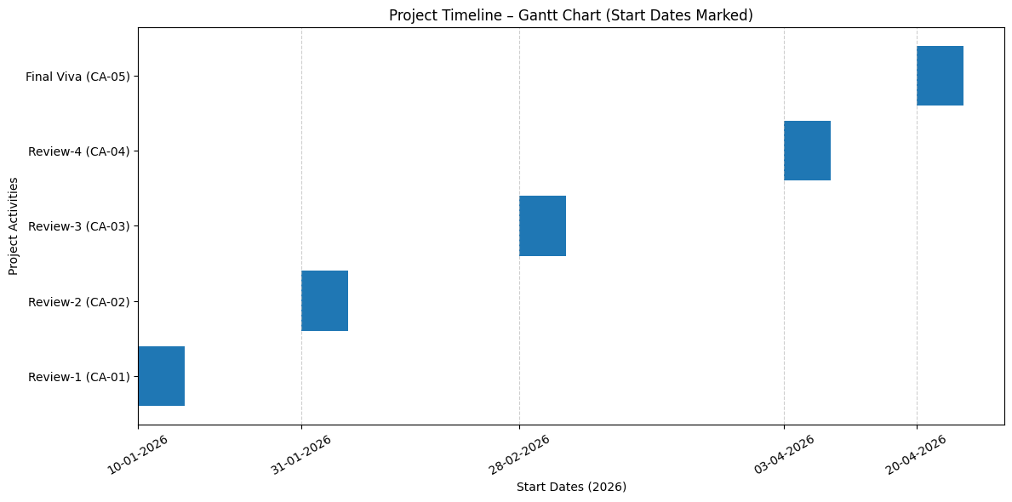
Timeline of the Project (Gantt Chart)

Slide 12
Github Link
https://github.com/aadityaa2611/ISE_02-University-Project

Slide 13
References (IEEE Paper format)
1.S. Chakraborty, K. Karthik and S. Banik, "Graph Synthesis for Pig Breed Classification From Muzzle Images," in IEEE Access, vol. 9, pp. 127240-127258, 2021, doi: 10.1109/ACCESS.2021.3111957
Link: https://ieeexplore.ieee.org/document/9535496
2. A. Biglari and W. Tang, "A Vision-Based Cattle Recognition System Using TensorFlow for Livestock Water Intake Monitoring," in IEEE Sensors Letters, vol. 6, no. 11, pp. 1-4, Nov. 2022, Art no. 5501404, doi: 10.1109/LSENS.2022.3215699.
Link: https://ieeexplore.ieee.org/document/9924566
3. R. -W. Bello, A. S. A. Mohamed and A. Z. Talib, "Contour Extraction of Individual Cattle From an Image Using Enhanced Mask R-CNN Instance Segmentation Method," in IEEE Access, vol. 9, pp. 56984-57000, 2021, doi: 10.1109/ACCESS.2021.3072636.
Link: https://ieeexplore.ieee.org/document/9400819

Slide 14


